Slide 1
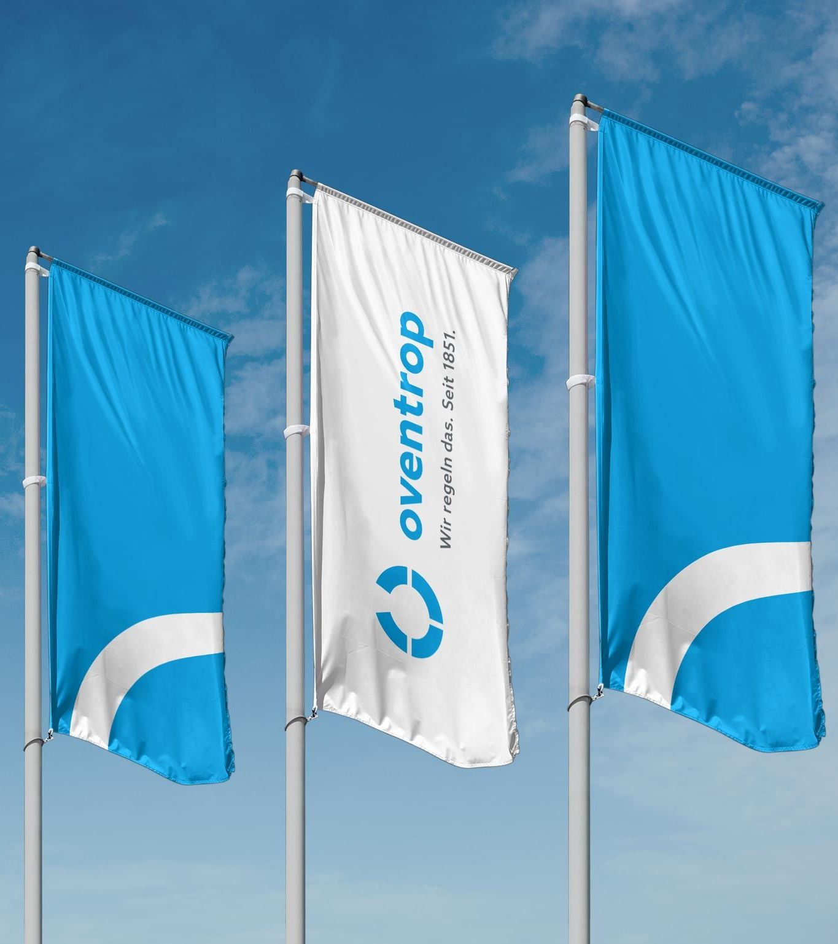
Company Presentation
Oventrop
Olsberg, 25 October 2022

Slide 2
The Oventrop Brand
Olsberg, 25 October 2022

Slide 3
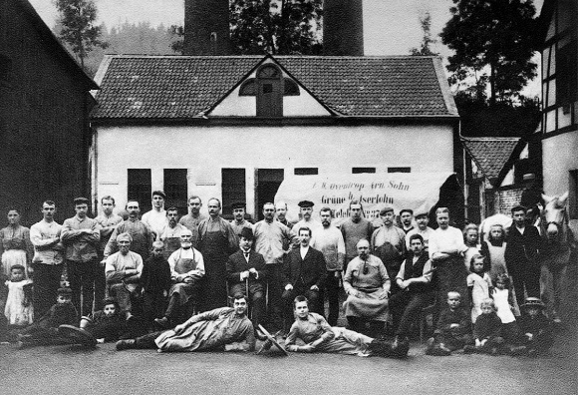
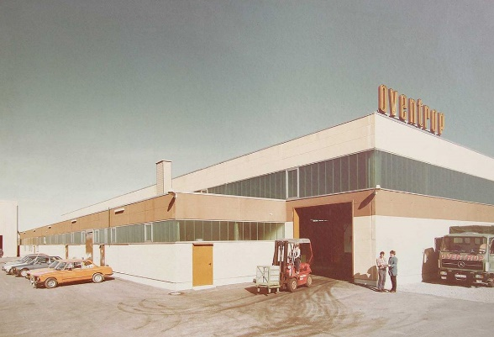

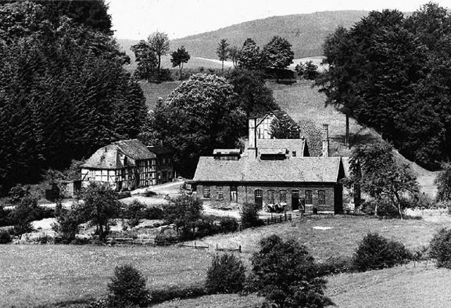
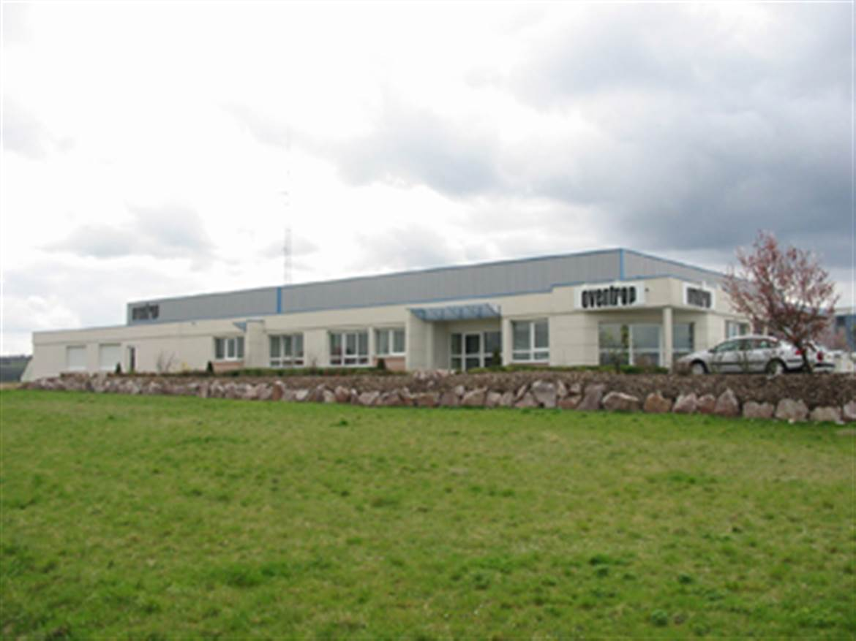
The Oventrop Brand
Our historical development - 170 years Oventrop
1851
Arnold Oventrop (1820-1871) founds the Arnold Oventrop & Co. Messing- and Broncewarenfabrik in Altena, Germany.
1980
Opening of the production plant in Brilon, Germany.
1886
The town of Altena is now highly industrialised. Labour becomes scarce and Oventrop relocates production to various locations in the Sauerland – among others to Iserlohn and Bigge, Germany.
1983
Opening of the first subsidiary in Wasselonne, France.

Slide 4
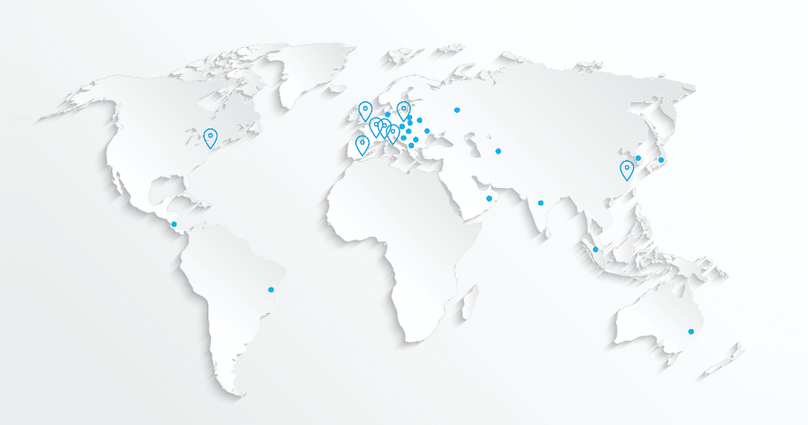
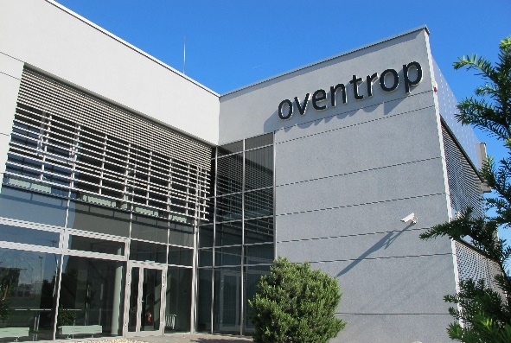
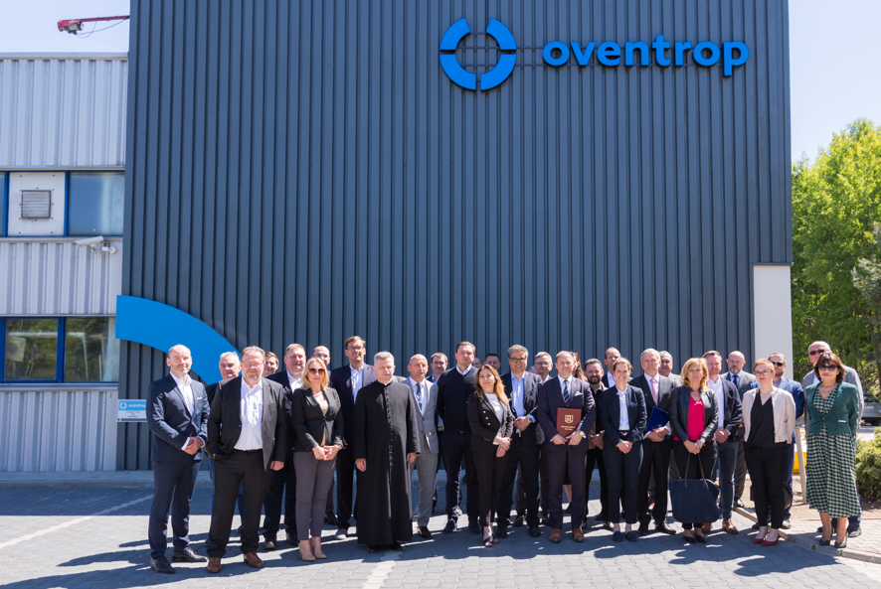
The Oventrop Brand
Our historical development- 170 years Oventrop
1995
Opening of the subsidiary in England.
1996-2021
Opening of further subsidiaries e.g. in China and Russia as well as numerous representations. Purchase and integration of Kring.
1995
Opening of the subsidiary in Warsaw, Poland.
2022
Opening of our new production site in Szydłowiec, Poland.

Slide 5

The Oventrop Brand
Our Vision
Vision:
With our modular components, subsystems and data-driven business models and services, we efficiently regulate energy flows in home and building technology – and we are continuously developing in new business areas.
Our customer-centric, intelligent solutions make a pioneering contribution to climate protection.
As a family-owned company in the Sauerland region, we strive for international growth, together with our partners. In this way, we secure our locations and international supply chains in the long term.
Who are we?
Family-owned company
Self-reliant and financially independent
Attractive employer
Our core brand is “Oventrop“
What are we?
We see ourselves as an internationally active family-owned company with origin and culture from the Sauerland.
se

Slide 6




The Oventrop Brand
Facts and Figures 2021.
222 Mio.€
Annual turnover
1200+
Employees
5500+
Products in the portfolio
35x
Sites and representations

Slide 7
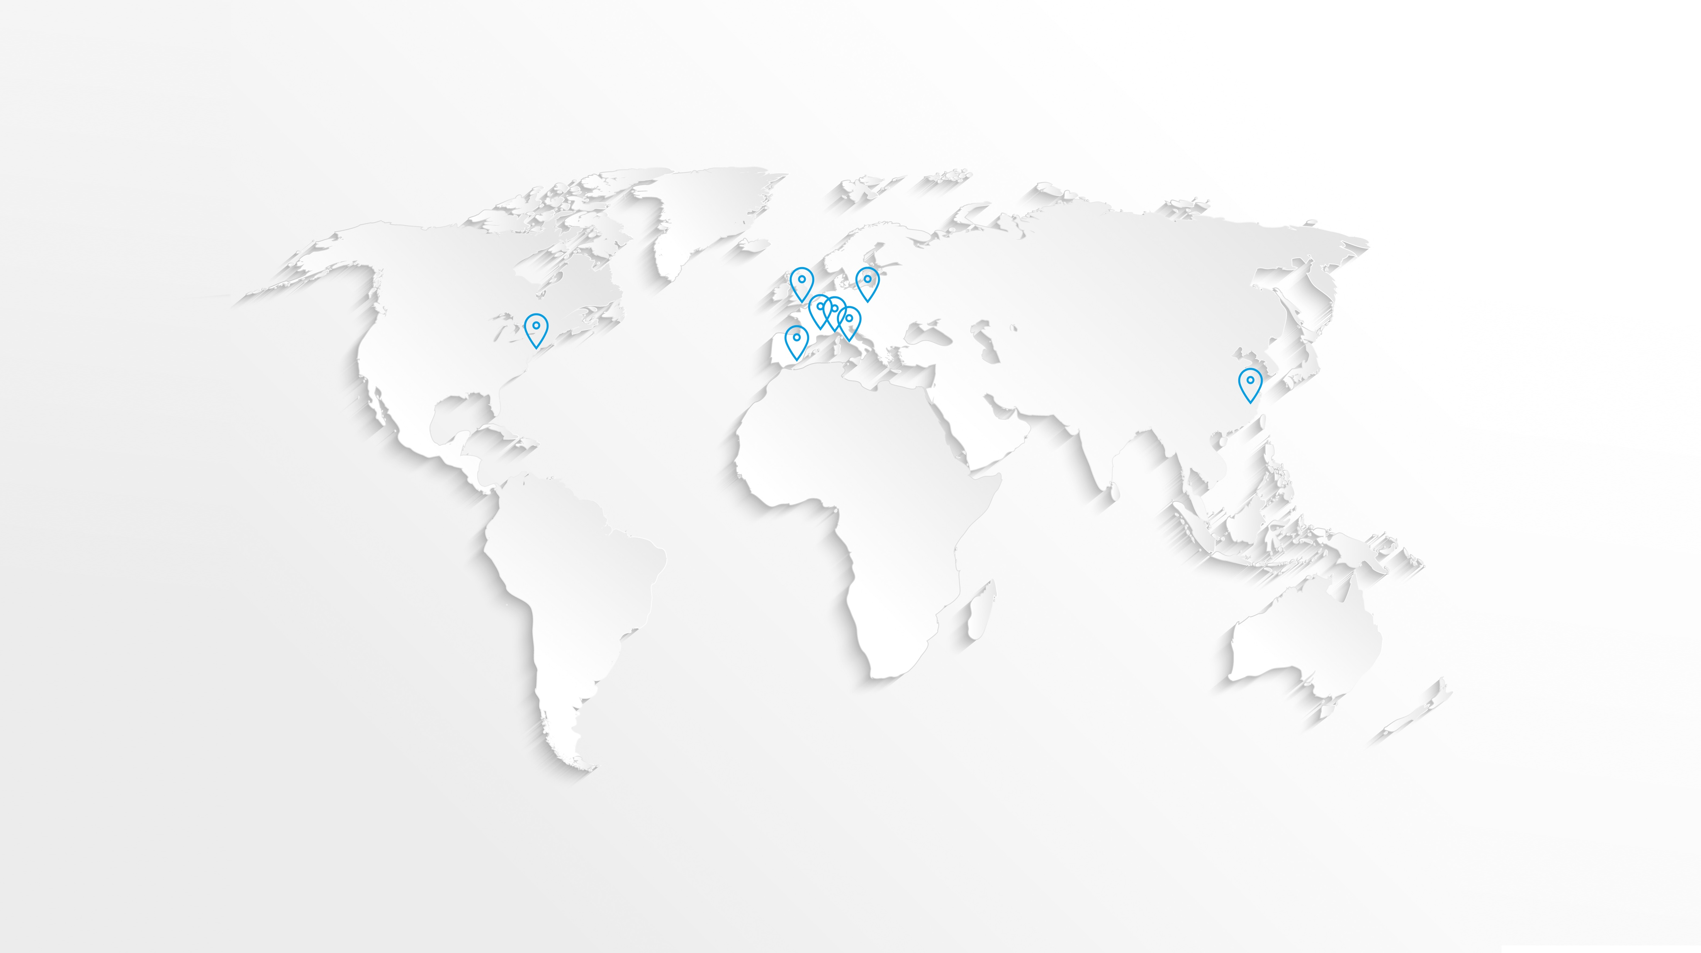


The Oventrop Brand
Worldwide presence via subsidiaries and representations
International
4 production sites in Germany, Poland and China
7 subsidiaries, among others in the USA, Great Britain and China
24 representations
Opening up East Asian markets
Subsidiaries
Representations

Slide 8
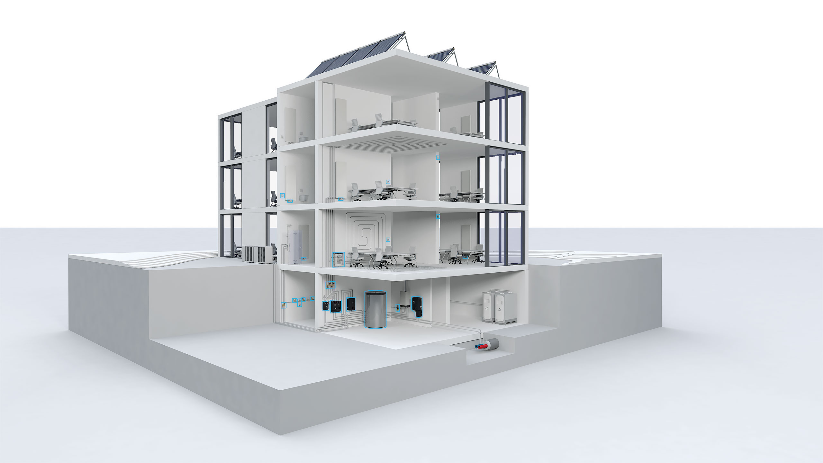








The Oventrop Brand
Modular Products & Systems
Modular Products & Systems
6 competence fields
5500 modularly combinable products
Efficiency guarantors
Perfect hydronic balancing
Room climate
Smart Home
Hydronics
Oil
Potable water
Stations

Slide 9
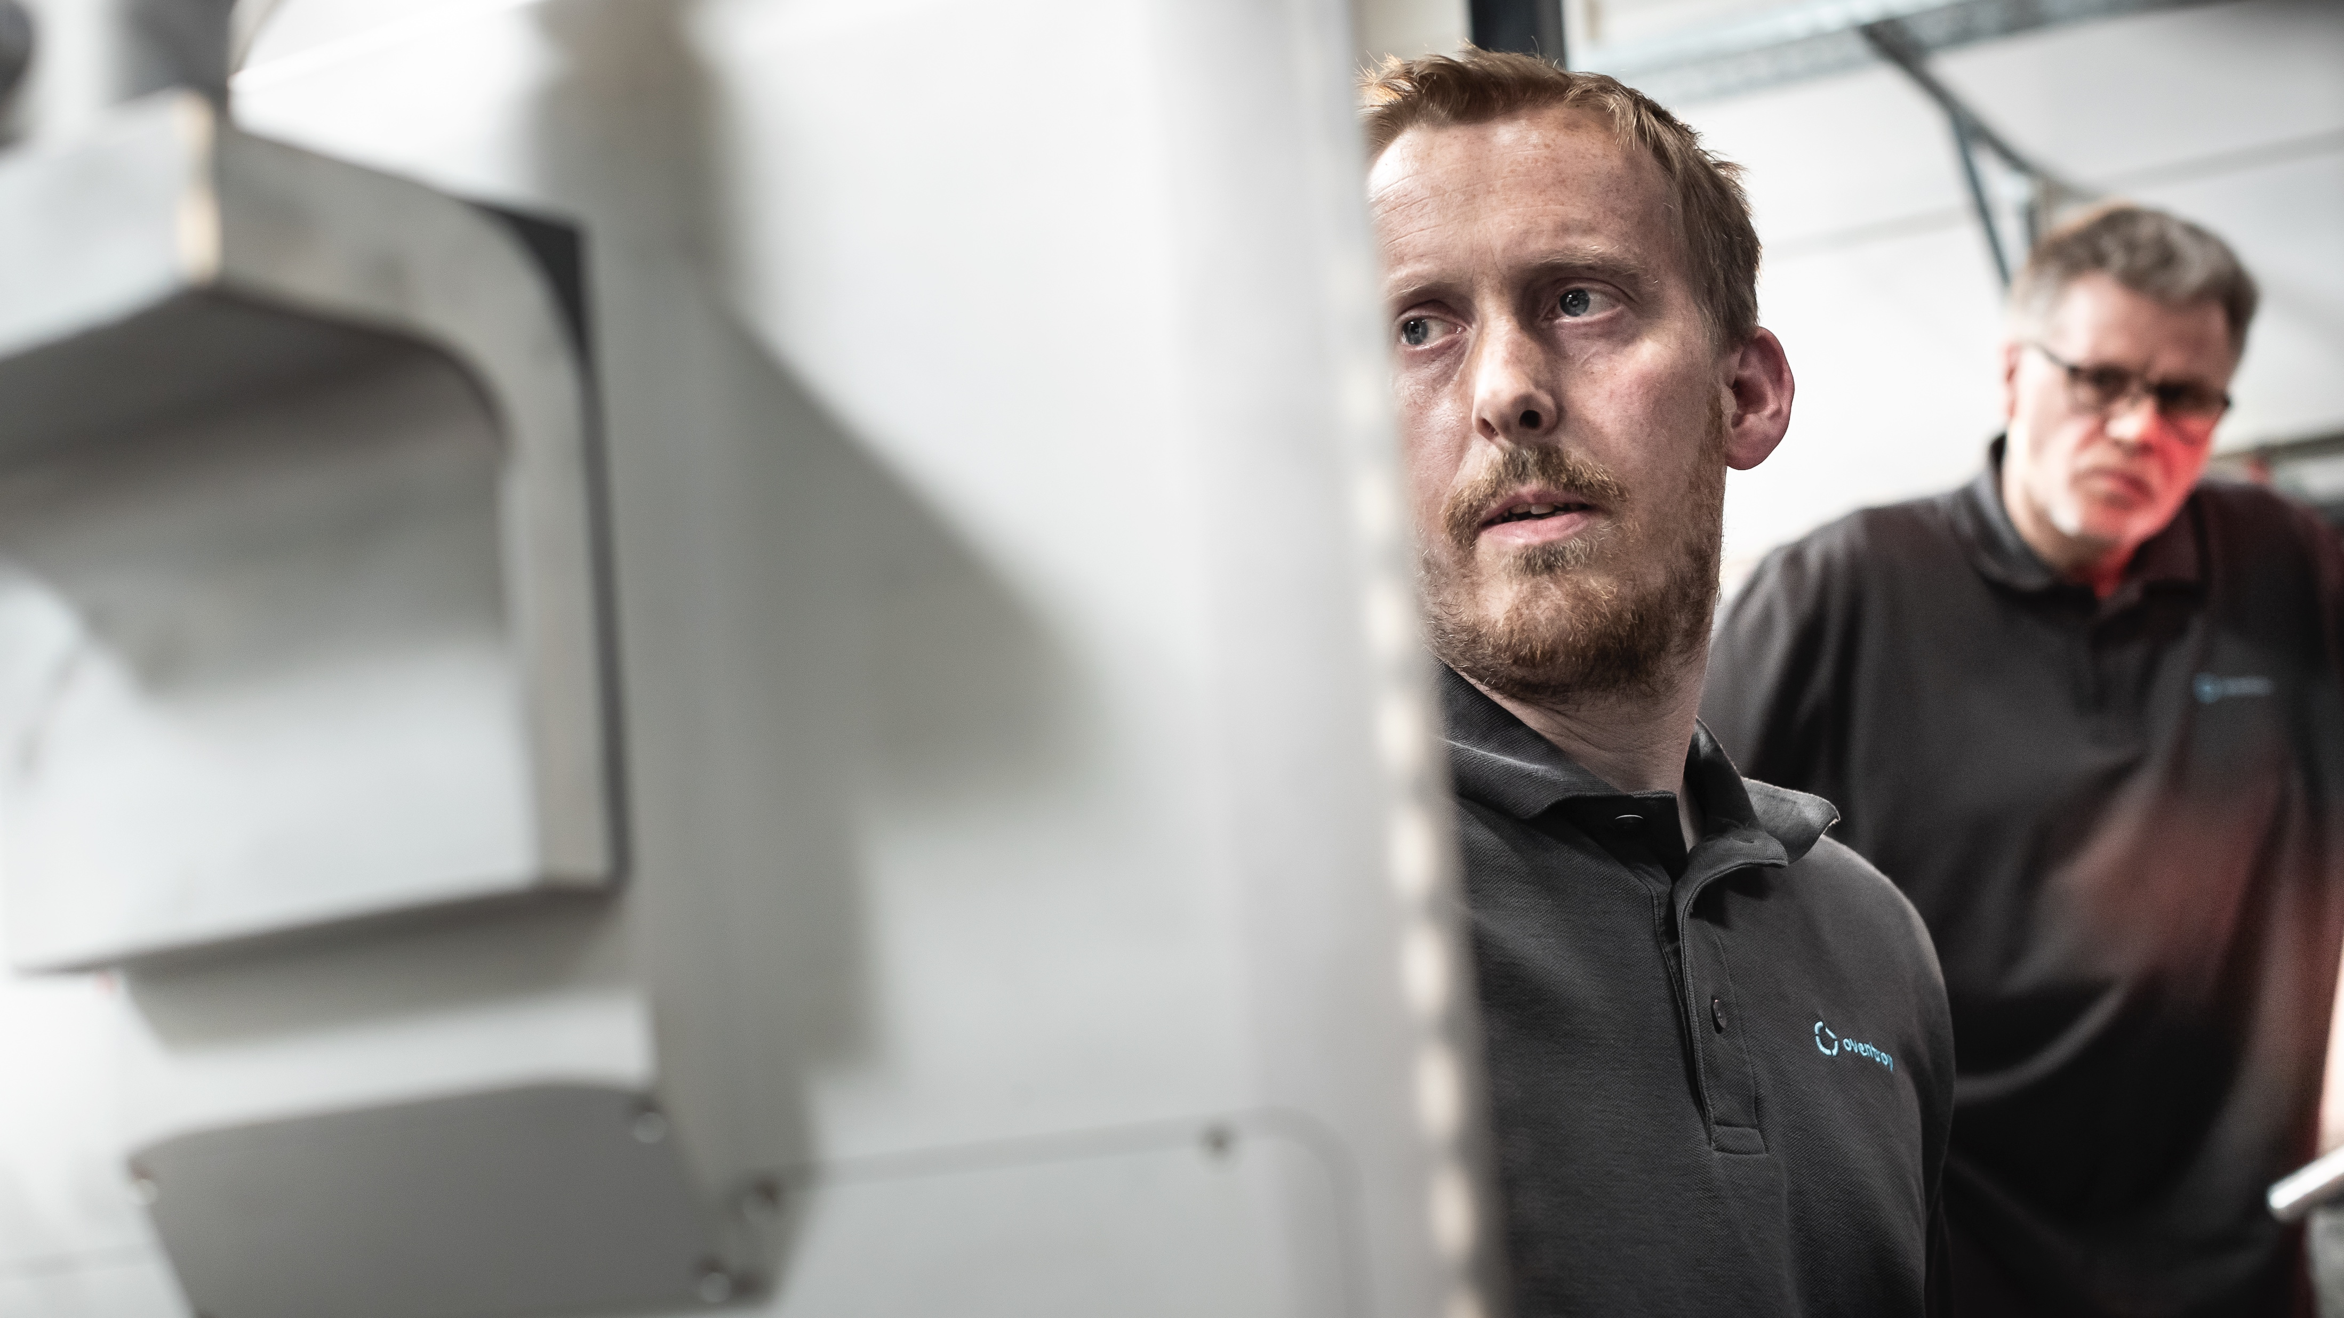

The Oventrop Brand
Modular Services
Modular Services
System design
Support during commissioning
Service calls
Laying service
Software (OVplan, commercial apl.)
Modulare Services
Technische Beratung
Fördermittel-, Wärme-, Thermostatcheck
Auslegung aller Art von Anlagen
Vertriebsstandarten
Building Information Modeling
Außendienst (Beratung &Technik)
Hotline

Slide 10


The Oventrop Brand
Academy
Oventrop Academy
35+ different courses
Face-to-face events
Online seminars
Online courses
Company events (incl. factory tours, sports activities, etc.)

Slide 11
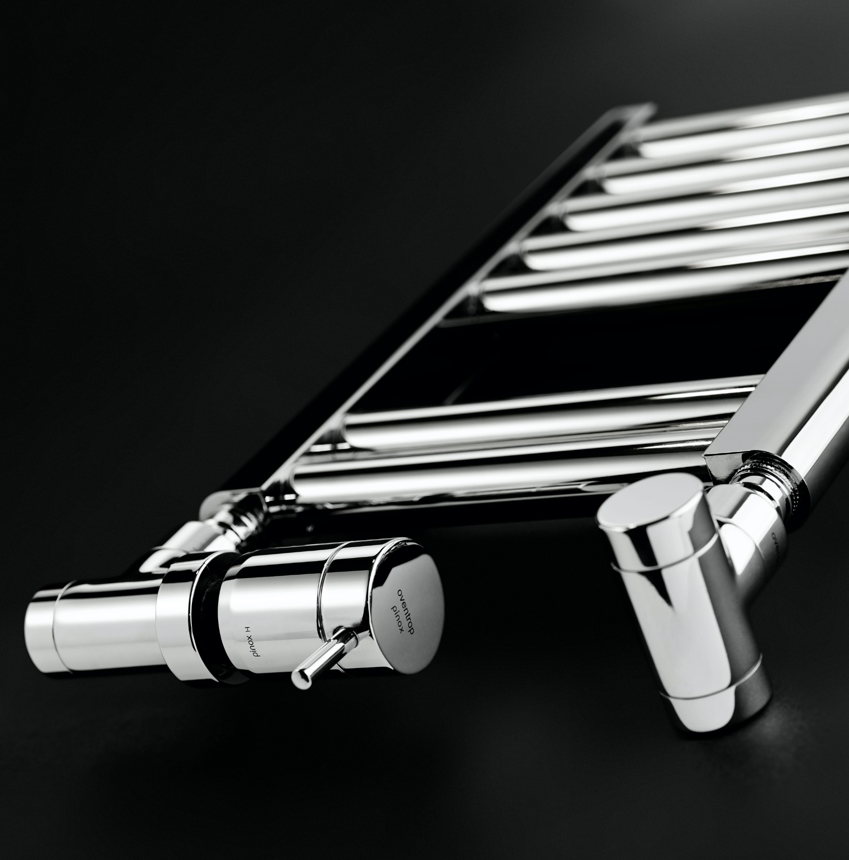

The Oventrop Brand
Innovation & Design
Design
50+ design and innovation awards
Design partner PHOENIX Design
Design and production developed in-house

Slide 12


The Oventrop Brand
Study & Apprenticeship
Study & Apprenticeship
Training of own HVAC or hydronic specialists
7 students
68 apprentices

Slide 13
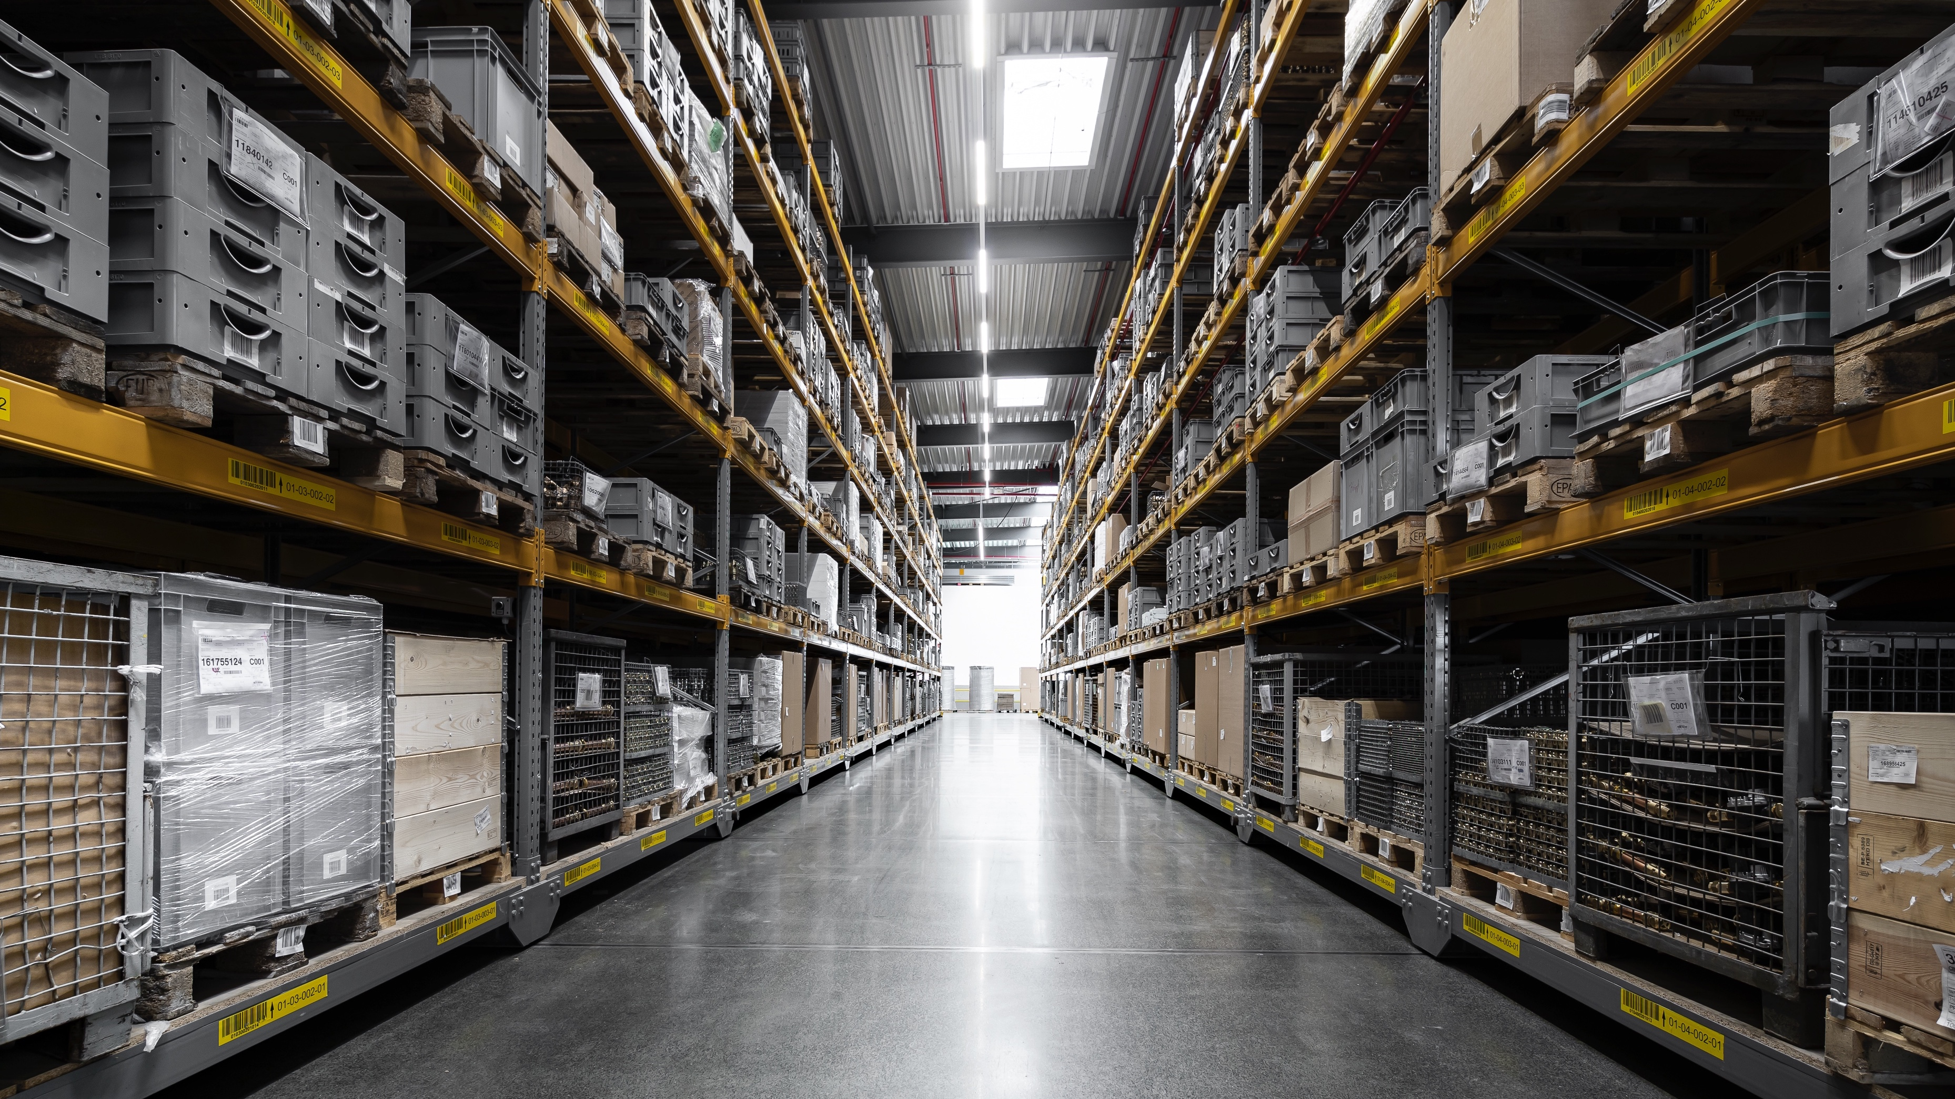
The Oventrop Brand
Logistics
Logistics
Implementation of a new PIM and ERP system
Continuous investment in process optimisation

Slide 14
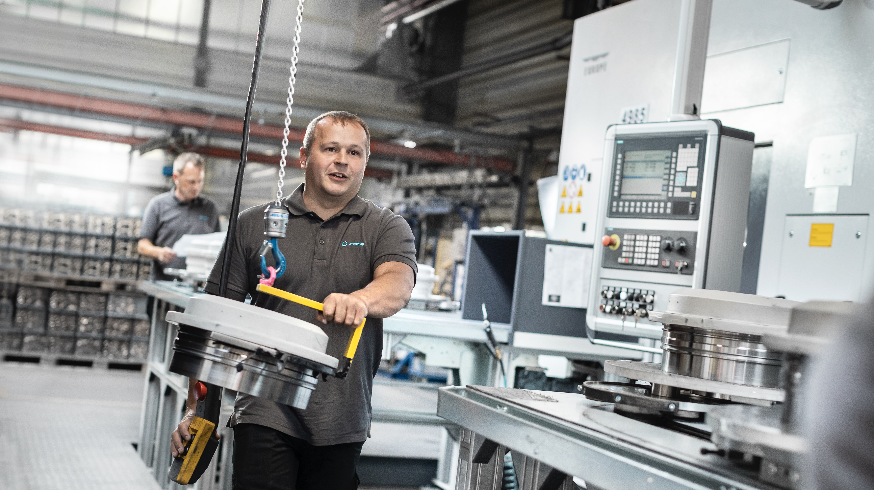

The Oventrop Brand
Production – Industry 4.0
Production – Target Industry 4.0
Factory 2024
Investment in production
Capacity expansions & fully automated production lines

Slide 15
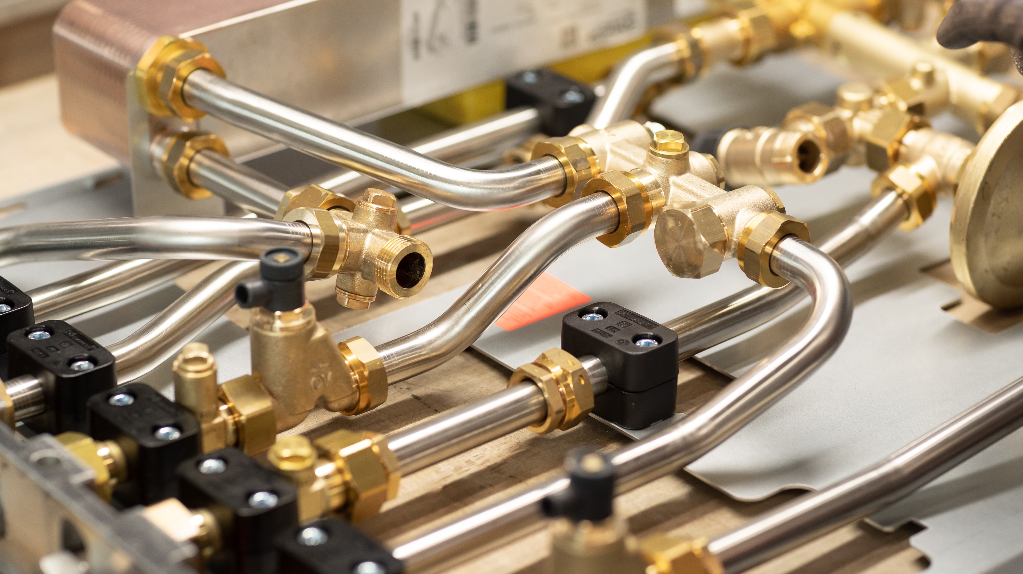
The Oventrop Brand
Quality
Quality
Highest quality standards
Continuous investment in quality management

Slide 16
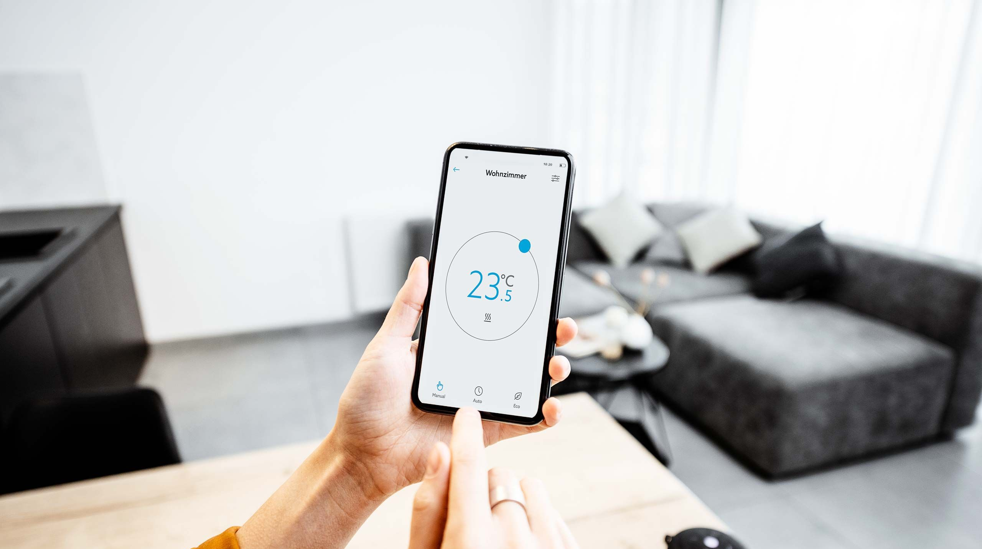


The Oventrop Brand
Digitalisation & Software
Digitalisation & Software
Oventrop website, e.g. product search, product information, product downloads
Oventrop app, e.g. design and planning functions (B2B)
Brand portal
Oventrop app (B2C)
Bsp. B2C App

Slide 17
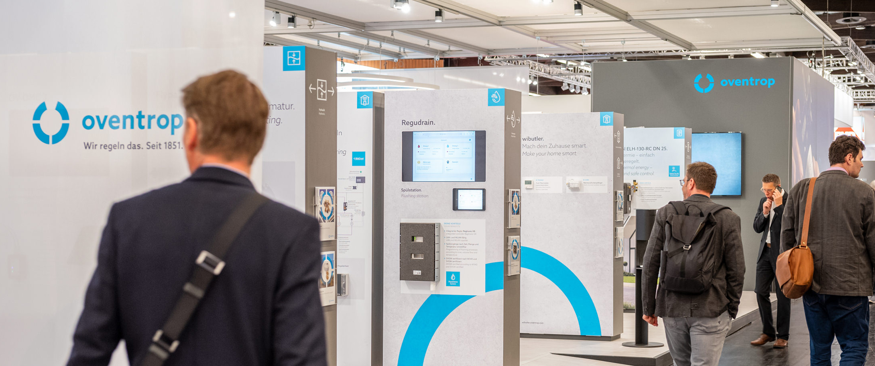
The Oventrop Brand
Our new live appearance – trade fairs 2022

Slide 18
Production Sites

Slide 19
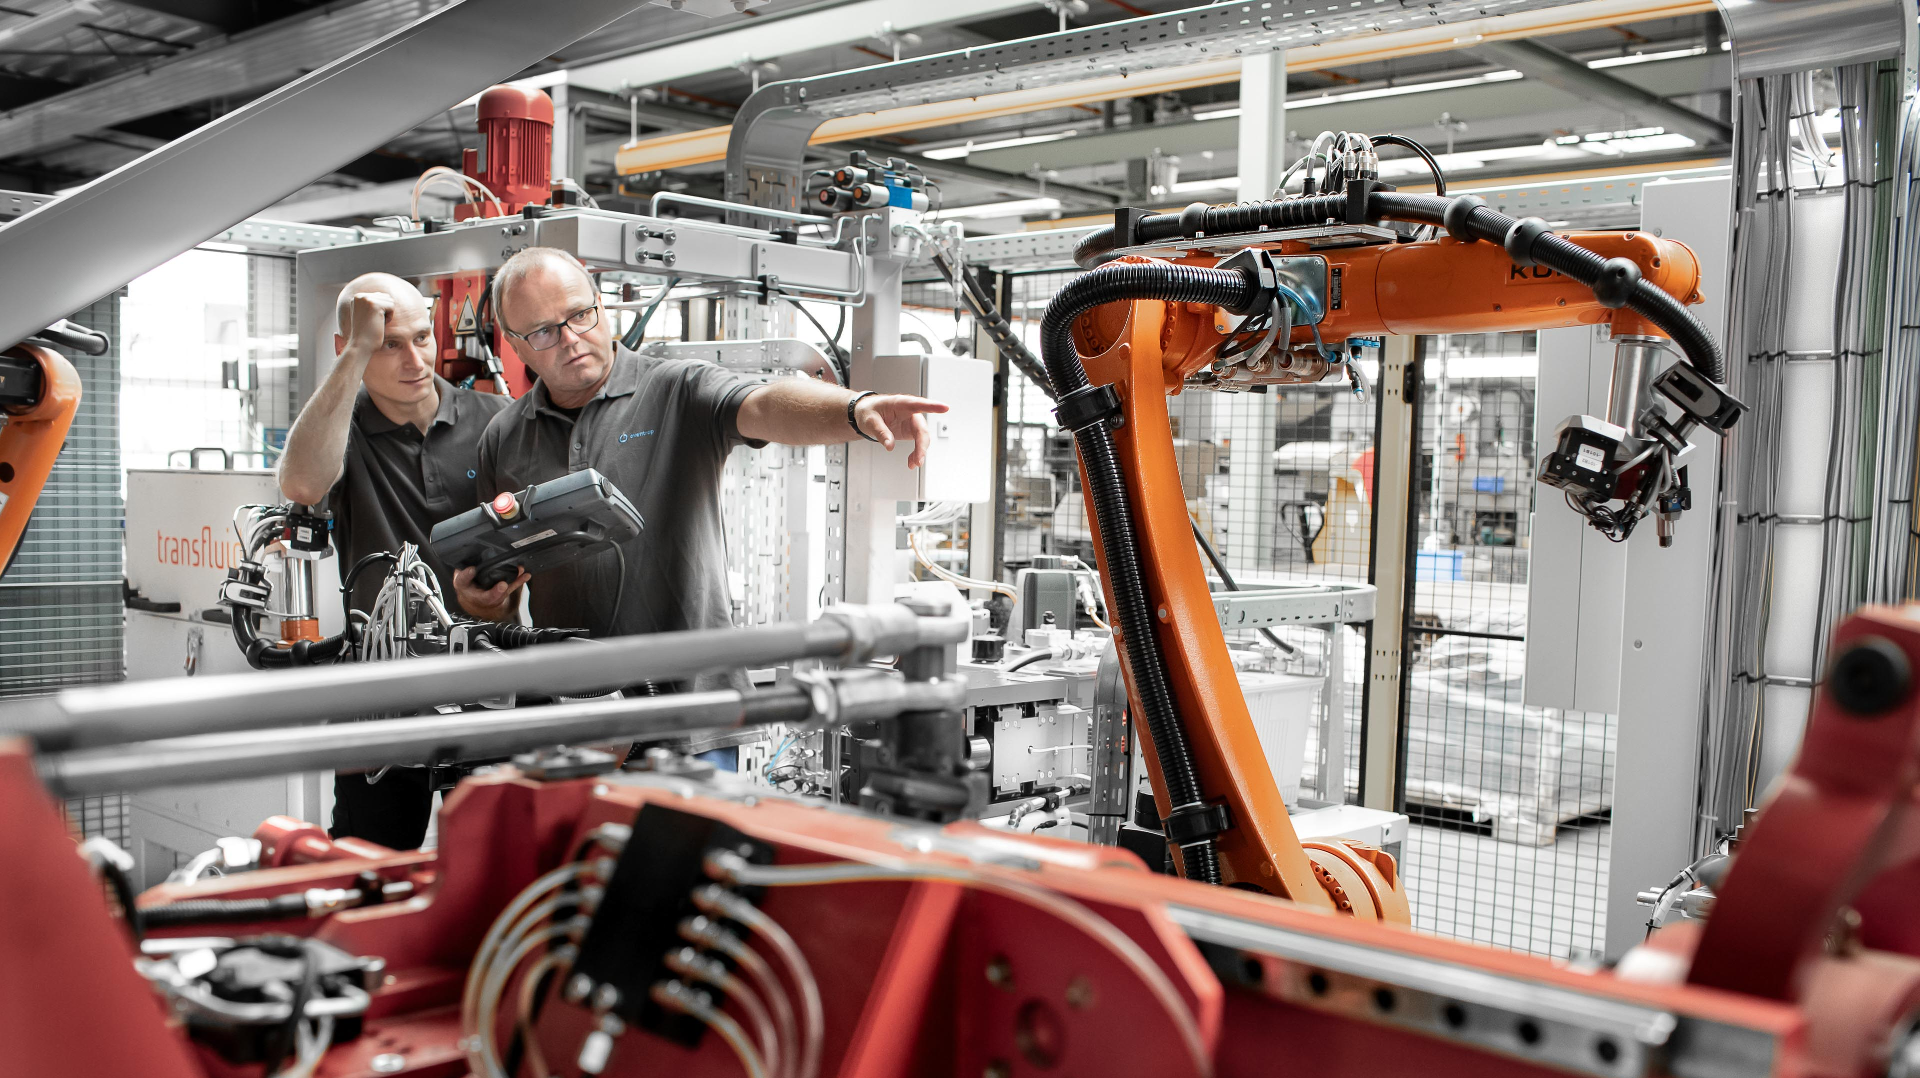

Production Site
Brilon
Brilon - Germany
Pressing plant
Mechanical machining on automatic and semi-automatic machines
Assembly halls
Central incoming goods department
Finished goods warehouse (15,000 m²)
Logistics and dispatch

Slide 20
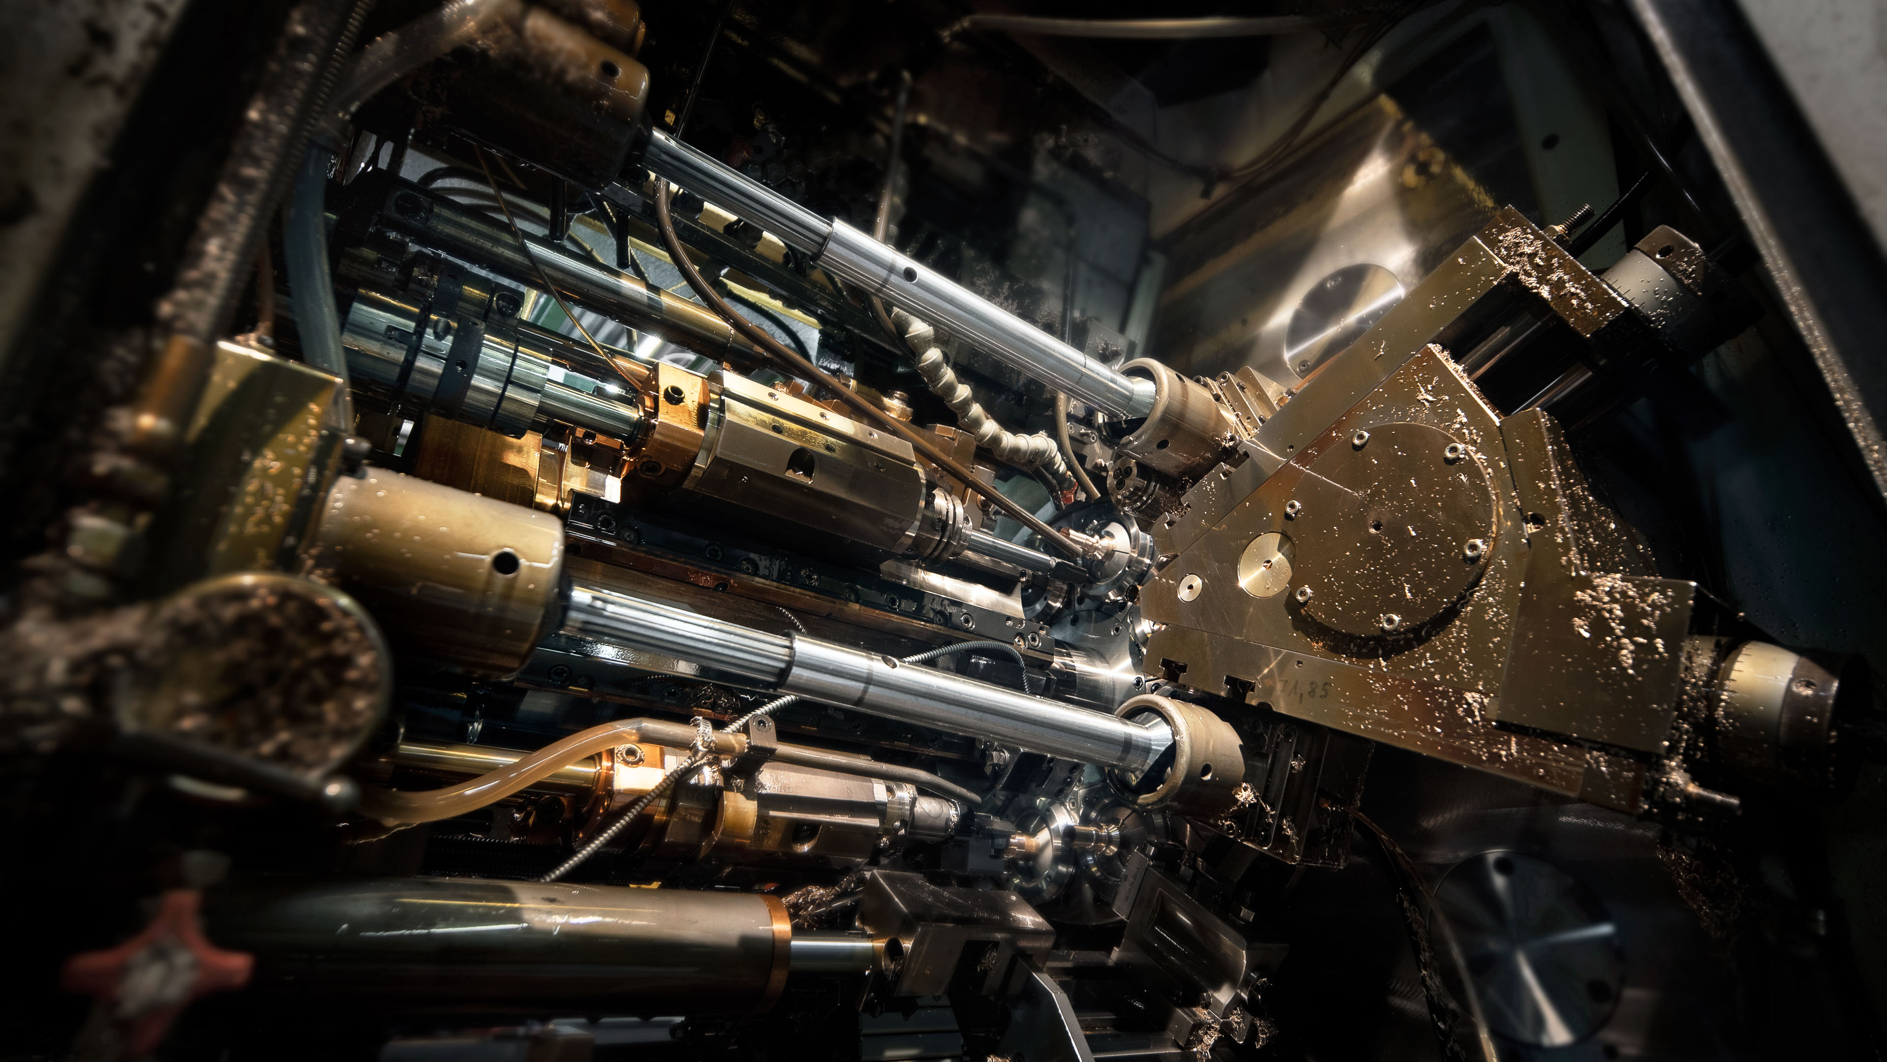
Production Site
Olsberg
Olsberg - Germany
Development department
Sales and Marketing
Customer Service
Foundry
Plastics production
Administration
Competence Centre

Slide 21
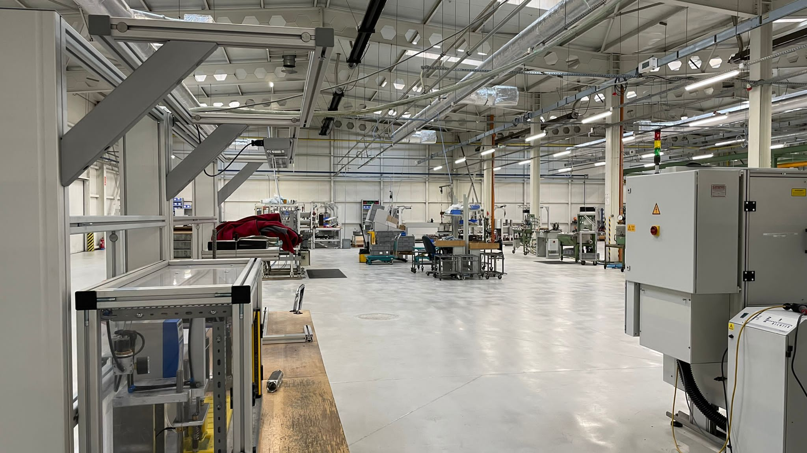
Production Site
Szydłowiec
Szydłowiec - Poland
Series production
Cocon pressure independent control valves
HydroControl double regulating and commissioning valves
Hycocon and Hydromat differential pressure regulators
Multidis heating circuit distributors/collectors

Slide 22
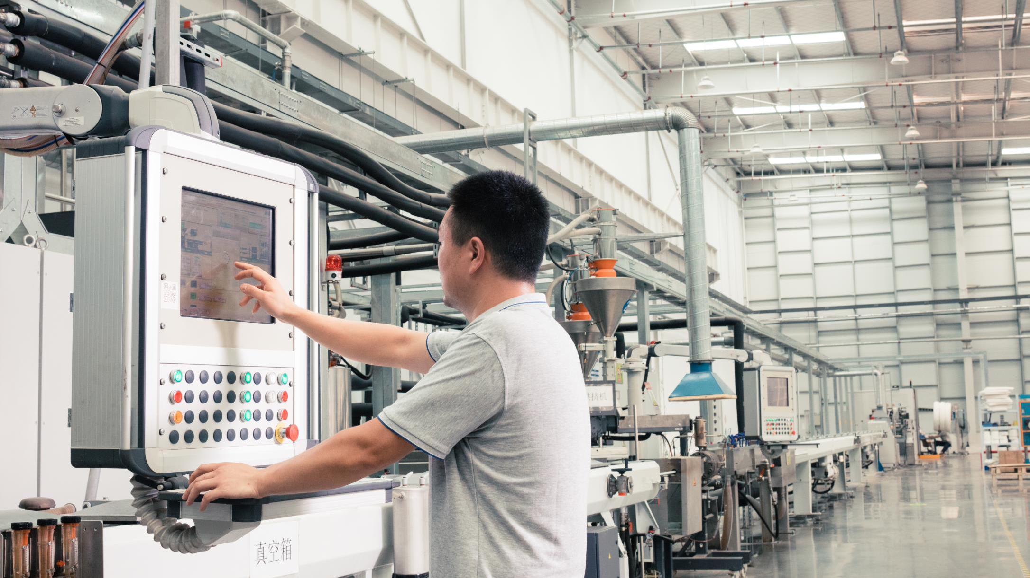
Production Site
Tianjin
Tianjin - China
Production for the Chinese market
Distributors/collectors for surface heating
Plastic pipes for surface heating
Dwelling stations

Slide 23
Thank you very much for your attention!

